Slide 1
WELCOME Case Study-3
Guided by: Mr Bose
Student: Venkatesh D.s
Academic:20192020

Slide 2
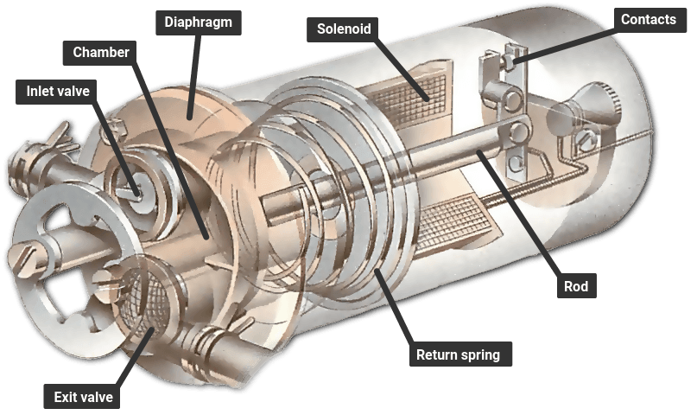
Analysis of defects in Automobile Fuel pump

Slide 3
Introduction…
The basic way your modern electrical fuel pump works is by utilizing a DC motor in the pump assembly which draws in the fuel sitting in your gas tank. From there, it sends it up the fuel line and into the fuel rail where it can be injected into a cylinder. It then mixes with air and a spark to create combustion.
There's a filter on the end of your pump that keeps any impurities in your tank from entering the fuel line. Additionally, there's a fuel float which literally floats on top of your fuel. This float has an arm attached to it that sends a signal through an electrical board. This resistance is read by your fuel gauge and tells you how much fuel is left in your tank. There's also another electrical resistor that is submerged, but when it's exposed to the air it knows you're very low on gas and tells your Low Fuel Warning light to illuminate.

Slide 4
Some of major causes of defects in fuel pump……
Manufacturing Defects
Poor Quality of materials
Improper design
Unskilled worker
Poor quality check
Poor Material handling
Vibration of metal parts
Equipment
Filters are not Cleaned properly
Pressure regulators not releasing excess pressure out
Pump receives high voltage ,which increases temperature .

Slide 5
To be Continued…….
Measurement
Input Pressure from pressure regulator is not checked
Input voltage is not checked .
Vibration of metal parts is not checked.
Suction pressure from pump is not noted.
People
Caliberation of pressure relief value is not done
Filters are not replaced frequently.
Motor parts are not allign properly
Electrical components are not connected properly.

Slide 6
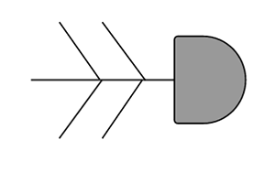
By combining all this causes we draw the Ishakawa diagram[Fishbone diagram]..

Slide 7
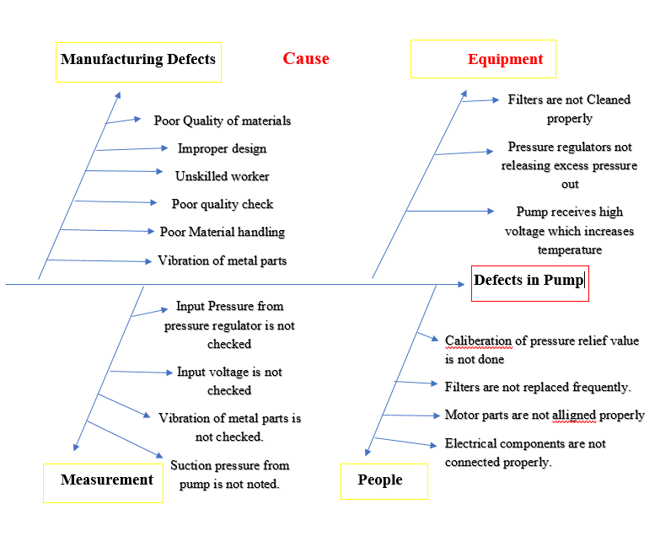
Fish bone diagram.

Slide 8

From above Fishbone Diagram.
We can find the cause for the defects in the Fuel Pump.

Slide 9

Thank you….

